Slide 1

AbbVie
THE RESULTS OF A NORWEGIAN PATIENT SURVEY

Slide 2
BACKGROUND
In Norway, around 25 000 people are affected by the chronic bowel diseases Ulcerative Colitis and Crohn's disease. This is known as Inflammatory Bowel Diseases (IBD) - which lead to social isolation, severe pain, involuntary breaks in employment and studies, and a reduced quality of life. IBD most commonly affects people between the ages of 17 and 35.
In collaboration with AbbVie Norway, the Norwegian National Association against digestive disorders (LMF) has conducted a patient survey about their life with IBD, the results of which were launched in May 2013.

Slide 3
AIMS AND OBJECTIVES
Primary Objective
To use the results of the patient survey to identify the specific problems and complications for people diagnosed with IBD
Secondary Objectives
To use the results of the survey as a tool to raise public awareness of the diagnosis
To use the results as a contribution to improve IBD patients’ quality of life in the long run

Slide 4
METHODS
Data Collection
The survey was led by the Norwegian National Association against digestive disorders (LMF) in collaboration with AbbVie Norway, and conducted among LMF’s members.
  An independent consultant, Geelmuyden.Kiese, was engaged to conduct the survey and analyze the results

Slide 5
RESULTS - 1
Key findings from the patient survey
424 people responded to the survey within 3 weeks
333 of the respondents were women. 92 were men.
9 out of 10 respond that they feel unusually tired and exhausted due to the diagnosis
8 of 10 respond that they feel their quality of life has been reduced due to the diagnosis
7 of 10 respond that the diagnosis has made it more difficult to attend work and/or studies
7 of 10 cannot, due to the diagnosis, live as they whish
6 of 10 are now more isolated from their surroundings than before the diagnosis
9 of 10 has experienced to fail to attend social gatherings due to the diagnosis

Slide 6
RESULTS - 2
Key findings from the patient survey
7 of 10 respond that the diagnosis makes it difficult to attend training and keep in shape
7 of 10 say that they have had to reduce leisure activities due to the diagnosis
6 of 10 has experienced not being able to travel due to the diagnosis
Almost half of the respondents have had to quit a job due to the diagnosis
One in three say that they have had to interrupt work or studies because of the diagnosis
Only half respond that their employer has assisted in facilitating their working conditions so they may perform their job despite the illness
Approximately 15 % respond that their diagnosis has made it more difficult to find a partner

Slide 7
RESULTS
Media coverage
Several media outlets covered the results of the survey in May 2013
One of the largest national newspapers in Norway referred to the article on its front page
The largest commercial television station in Norway interviewed a patient in their studio on their morning show.
The Norwegian National Association against digestive disorders (LMF) published articles on their website

Slide 8

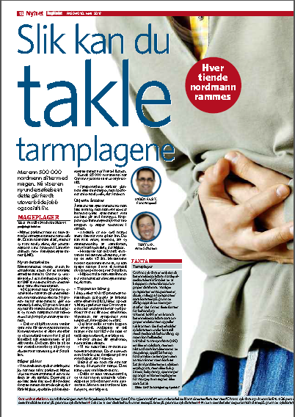
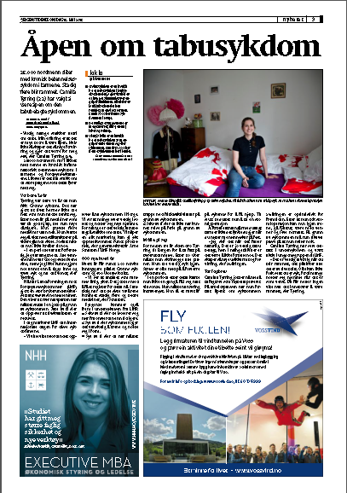
RESULTS
Media coverage of the survey results

Slide 9
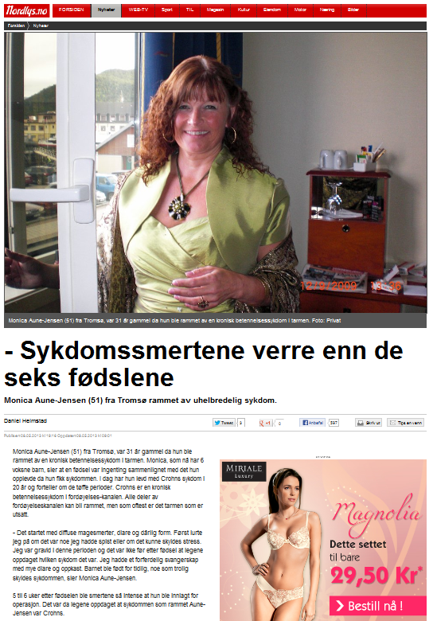
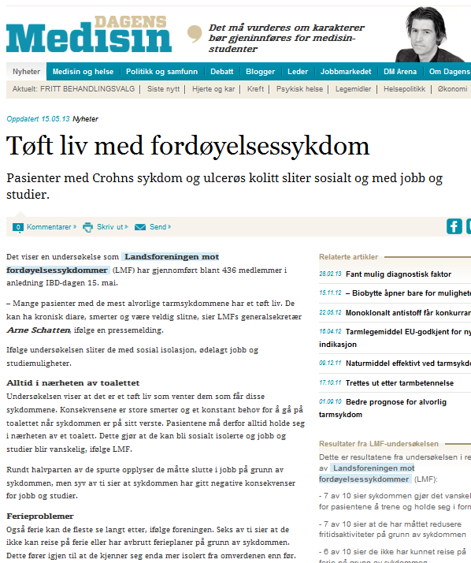
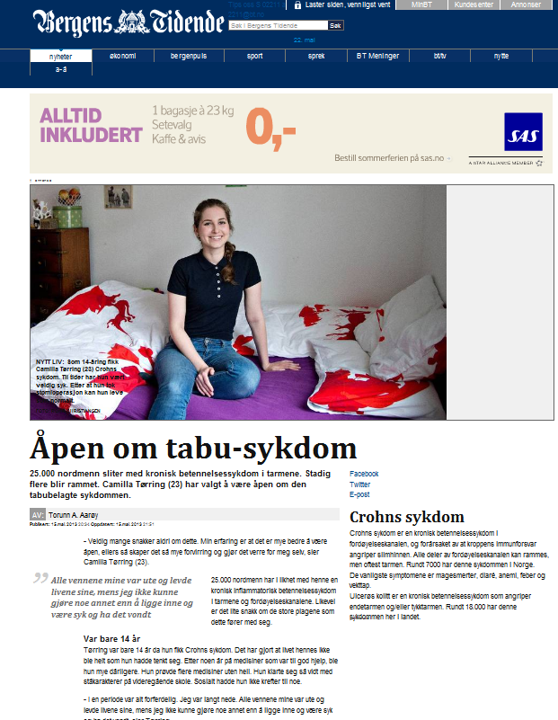
RESULTS
Media coverage of the survey results

Slide 10
CONCLUSIONS
Data from the patient survey showed that IBD patients’ quality of life has been reduced due to the diagnosis
The survey also revealed the seriousness of the reported, with a majority of the respondents answering that they feel unusually tired and exhausted, isolated and unable to travel due to the diagnosis, among other things.
Increased knowledge about the disease and the importance of earlier diagnosis are key for patients to get the right kind of treatment.
Through a media and PR campaign, the Norwegian National Association against digestive disorders (LMF) in collaboration with AbbVie Norway, have leveraged the results of the survey to improve awareness within the medical and political communities and among the general public.

